Slide 2
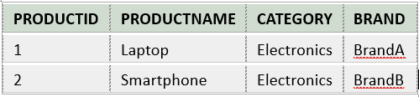
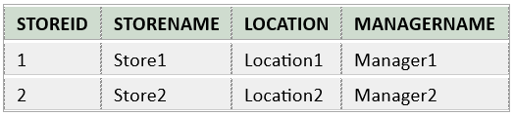
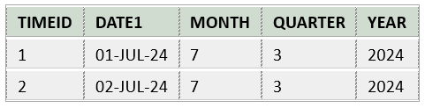
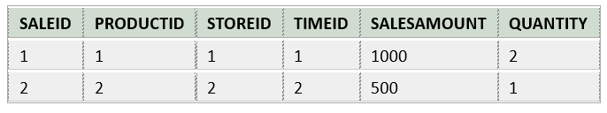
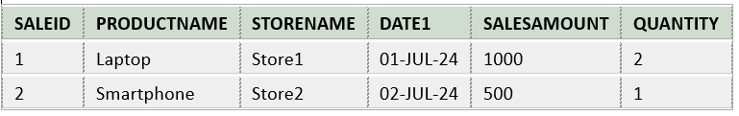
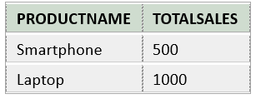


Slide 3
CREATE TABLE ProductDimension (
ProductID INT PRIMARY KEY,
ProductName VARCHAR(100),
Category VARCHAR(50),
Brand VARCHAR(50)
);
CREATE TABLE StoreDimension (
StoreID INT PRIMARY KEY,
StoreName VARCHAR(100),
Location VARCHAR(100),
ManagerName VARCHAR(100)
);
CREATE TABLE TimeDimension (
TimeID INT PRIMARY KEY,
Date DATE,
Month INT,
Quarter INT,
Year INT
);
CREATE TABLE SalesFact (
SaleID INT PRIMARY KEY,
ProductID INT,
StoreID INT,
TimeID INT,
SalesAmount DECIMAL(10, 2),
Quantity INT,
FOREIGN KEY (ProductID) REFERENCES ProductDimension(ProductID),
FOREIGN KEY (StoreID) REFERENCES StoreDimension(StoreID),
FOREIGN KEY (TimeID) REFERENCES TimeDimension(TimeID)
);

Slide 4
INSERT INTO ProductDimension (ProductID, ProductName, Category, Brand) VALUES (1, 'Laptop', 'Electronics', 'BrandA');
INSERT INTO ProductDimension (ProductID, ProductName, Category, Brand) VALUES (2, 'Smartphone', 'Electronics', 'BrandB');
INSERT INTO StoreDimension (StoreID, StoreName, Location, ManagerName) VALUES (1, 'Store1', 'Location1', 'Manager1');
INSERT INTO StoreDimension (StoreID, StoreName, Location, ManagerName) VALUES (2, 'Store2', 'Location2', 'Manager2');
INSERT INTO TimeDimension (TimeID, Date1, Month, Quarter, Year) VALUES (1, '01-Jul-24', 7, 3, 2024);
INSERT INTO TimeDimension (TimeID, Date1, Month, Quarter, Year) VALUES (2, '02-Jul-24', 7, 3, 2024);
INSERT INTO SalesFact (SaleID, ProductID, StoreID, TimeID, SalesAmount, Quantity) VALUES (1, 1, 1, 1, 1000.00, 2);
INSERT INTO SalesFact (SaleID, ProductID, StoreID, TimeID, SalesAmount, Quantity) VALUES (2, 2, 2, 2, 500.00, 1);
select * from ProductDimension;
select * from StoreDimension;
select * from TimeDimension;
select * from SalesFact;

Slide 5
Querying the Data - To retrieve sales data along with product and store details:
SELECT
sf.SaleID,
pd.ProductName,
sd.StoreName,
td.Date1,
sf.SalesAmount,
sf.Quantity
FROM
SalesFact sf
JOIN
ProductDimension pd ON sf.ProductID = pd.ProductID
JOIN
StoreDimension sd ON sf.StoreID = sd.StoreID
JOIN
TimeDimension td ON sf.TimeID = td.TimeID;

Slide 6
Aggregation Query - To calculate total sales per product:
SELECT
pd.ProductName,
SUM(sf.SalesAmount) AS TotalSales
FROM
SalesFact sf
JOIN
ProductDimension pd ON sf.ProductID = pd.ProductID
GROUP BY
pd.ProductName;

Slide 7
Time-Based Analysis - To analyze sales by quarter and year:
SELECT
td.Quarter,
td.Year,
SUM(sf.SalesAmount) AS TotalSales
FROM
SalesFact sf
JOIN
TimeDimension td ON sf.TimeID = td.TimeID
GROUP BY
td.Quarter, td.Year;

